Slide 1

SESSION · HUMAN RESOURCES
HR
ALTUS SUMMIT 2026 · CHICAGO
WORKFORCE OF THE FUTURE
RECRUITING
RETAINING
LEADING
Moderated by Channing Johnson — KB Building Services
///
01 / 06
ISSA · ALTUS COLLECTIVE

Slide 2


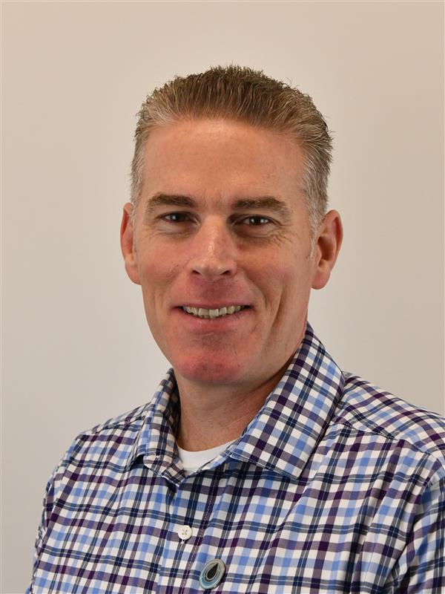
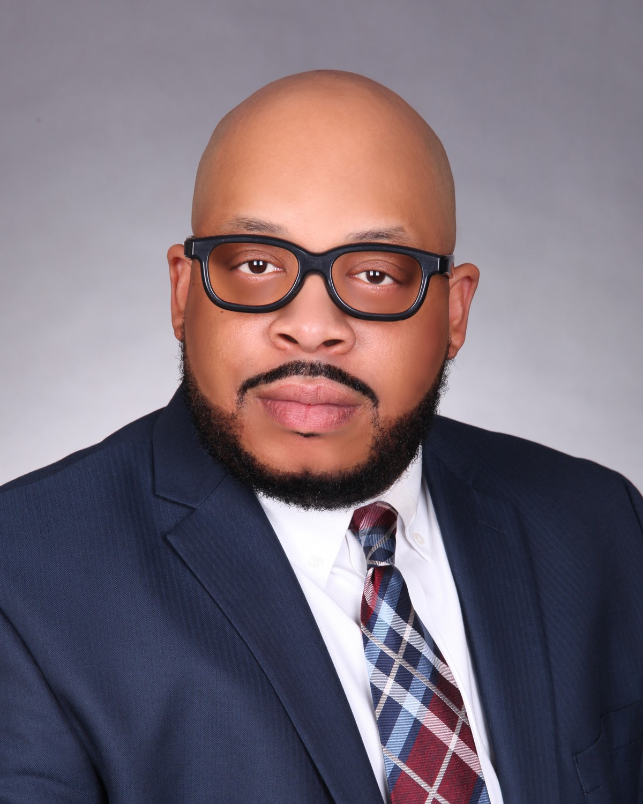
YOUR PANEL
WORKFORCE OF THE FUTURE
SPEAKERS.
MODERATOR
CHANNING JOHNSON
GERREN SPRAUVE
JOE BUSHEY
OTIS SCOTT
President
Founder
M.S.
Prestige Maintenance USA
KB Building Services
The Alignment Group, LLC
City Wide Facility Solutions
02 / 06
ISSA · ALTUS COLLECTIVE

Slide 3
DISCUSSION
?
TABLE QUESTION
WHAT IS YOUR BIGGEST WORKFORCE CHALLENGE TODAY?
///
03 / 06
ISSA · ALTUS COLLECTIVE

Slide 4
THE RESULTS
KB BUILDING SERVICES
WHAT THE PLAYBOOK DELIVERS.
92%
61%
2.5
AVERAGE OVERALL
FRONT LINE EMPLOYEES
AVERAGE # OF DAYS
EMPLOYEE RETENTION
3+ YEARS OF SERVICE
FROM APP TO START DATE
50%
66.8%
REDUCED HR ADMIN TEAM
REDUCED TURNOVER TO
04 / 06
ISSA · ALTUS COLLECTIVE

Slide 5
WORKFORCE OF THE FUTURE PLAYBOOK — ALTUS SUMMIT 2026
FOUNDATION
RECRUIT
RETAIN
LEAD
METRICS
START HERE
FIND & ATTRACT
KEEP & CONNECT
DEVELOP & INSPIRE
TRACK & PROVE ROI
MISSION · VISION · CORE VALUES
CULTURE & ATTITUDE
MAKE PEOPLE FEEL SEEN
MINDSET
RECRUITING
Know your why
Cast a clear vision of where you are going
Define company core values that are non-negotiable
Hire character first; skills can be taught
Complete same day interviews
Utilize social media
Consistent personal check-in's for all front line employees
Complete new hire pulse surveys — at 7 / 30 / 90 / 180 days
Intentional employee extra touches with drip messaging
Help people think; decision making matrix
Promote PLA — positive life attitude
Application to start date (# of days)
90 day new hire retention
RETENTION
Overall annual retention rate
Retention rate for appreciated employees
Employee tenure (% at X number of years)
Annual turnover rate
REFERRALS
DEVELOPMENT
Offer referral bonuses to existing employees
Spread out referral bonuses — at hire, 90 day / 180 day / 1 year / 2 year anniversaries
Monthly leadership training
Manager specific onboarding — why & what; not just the how
Create path to leadership program with milestone badges
Teach added skill classes — ESL, how to be a better leader, personal finance
CULTURE DNA
RECOGNITION
Wanted vs. not wanted traits list for each job role
Build a culture class before day 1
Hire & fire based on culture
Monthly awards & annual celebration
Handwritten thank you cards mailed home
Appreciation programs
PROCESS & TECH
LEADERSHIP
Structured interview guides for consistency
Utilize technology for HR admin duties
Ensure complete role clarity between departments
Internal promotion rate (% of employees)
Non-billable overtime (% of total payroll)
KEEP THEM INVESTED
Develop a shared purpose
Complete annual compensation market analysis
Focus on trust; autonomy = respect
STRUCTURE
Weekly / bi-weekly 1:1's for all leadership roles
Deliberately promote from within — share those stories
05 / 06
ISSA · ALTUS COLLECTIVE

Slide 6
ALTUS SUMMIT 2026
///
THANK YOU.
06 / 06
ISSA · ALTUS COLLECTIVE

