Slide 1

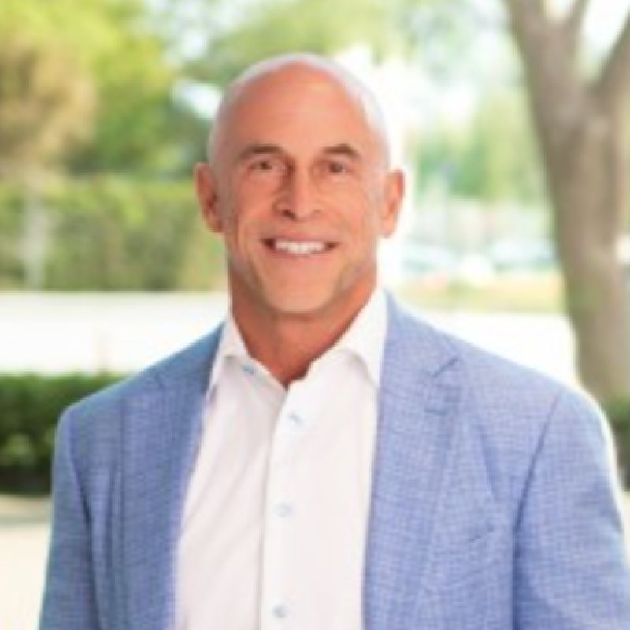
SESSION · STRATEGY
ALTUS SUMMIT 2026 · JUNE 8–10 · CHICAGO
MAXIMIZING ENTERPRISE VALUE.
M&A Trends & Strategies for BSC Leaders
Mark Herbick
Founder & CEO, Pursant
30+ years in M&A · Former BSC CEO · Harvard Business School
///

Slide 2
01
PART ONE
THE DATA.
Current M&A multiples in the BSC space — what buyers are paying and why.
///
ISSA · ALTUS COLLECTIVE

Slide 3
///
ALTUS
|
COLLECTIVE
01 · THE DATA
HOW BSCS ARE VALUED
Valuation Formula
BSC companies trade at multiples of EBITDA. Company, market, and buyer factors determine the range.
EBITDA
MULTIPLE
REPORTED
Enterprise Value
×
RISK PROFILE
=
ADJUSTED
VALUE DRIVERS
LTM
MARKET CONDITIONS
NTM
BUYER PROFILE
PROFORMA
ISSA · ALTUS COLLECTIVE

Slide 4
///
ALTUS
|
COLLECTIVE
01 · THE DATA
Valuation Multiples Over Time
Total Enterprise Value TEV/EBITDA — by Deal Size
9.5
10.3
9.3
8.5
9.2
8.5
7.5
8.3
8.3
8.1
8.1
8.3
6.5
7.2
6.4
7.1
6.9
6.4
6.8
6.4
6.8
5.8
6.1
5.9
2003–2020
2021
2022
2023
2024
2025
$10M–$25M
$25M–$50M
$50M–$100M
$100M–$250M
Source: GF Data

Slide 5
///
ALTUS
|
COLLECTIVE
01 · THE DATA
BSC Risk Profile & Value Drivers
These company-specific components affect the valuation multiple.
Financial
Financial profile — revenue, gross margin, and EBITDA level & trends
Customer
Customer/revenue/margin concentrations and dependency
Customer verticals — office, industrial, medical, retail, public vs. private
Metrics
Customer retention history
Managerial and sales strength
Ownership operational dependency
Ownership staying or leaving
Talent &
Leadership
Employment and/or subcontractor practices
Quality of record keeping — financial, HR, customers
Technology — QC, reporting, scheduling, timekeeping
Business
Practices + Technology

Slide 6
///
ALTUS
|
COLLECTIVE
01 · THE DATA
Business Services Multiples 2025
Total Enterprise Value by Transaction Value (TEV) / EBITDA or SDE
8.3×
10.3×
SDE
Seller's Discretionary Earnings
Deals under $5M
6.4×
6.8×
5.5×
3×
3.3×
2×
2×
EBITDA
$5M–$250M deals
<$500k
$500k–$1M
$1M–$2M
$2M–$5M
$5M–$10M
$10M–$25M
$25M–$50M
$50M–$100M
$100M–$250M
SDE
SDE
SDE
SDE
Source: GF Data, Pepperdine Private Capital Markets, PowerComps and Pursant LLC

Slide 7
02
PART TWO
STRATEGIC VS. FINANCIAL BUYERS.
Who's buying, what they're paying — and why PE is changing the math.
///
ISSA · ALTUS COLLECTIVE

Slide 8
///
ALTUS
|
COLLECTIVE
02 · BUYER TYPES
Premium Paid by Strategic Buyers
55% of deals now involve financial buyers (growing). 49% of strategic buyers paid a premium.
51%
So, who is the "better" buyer?
24%
It depends. How do you define "better" — and do you want some chips off the table, or are you cashing in and going home?
10%
10%
4%
1%
No premium
1–10% more
11–20% more
21–30% more
31–40% more
>50% more
Source: Pepperdine Private Capital Markets

Slide 9
///
ALTUS
|
COLLECTIVE
02 · BUYER TYPES
Exit Comparison — Strategic vs. Private Equity
STRATEGIC BUYER
PRIVATE EQUITY BUYER
All Cash at Close
Cash + Rollover Equity
$25M
$32.5M
Cash at closing — assumes no earnout
$20M cash at close
Clean break, full liquidity on day one
$5M rollover equity
One transaction, one payout
Rollover grows 2.5× to $12.5M over 5 years
Total proceeds: $32.5M
20% compound annual return
The "second bite of the apple" puts financial buyers in a position to pay more over time.

Slide 10
03
PART THREE
THE BUYER'S PLAYBOOK.
What buyers look for in a BSC acquisition target — and what kills deals.
///
ISSA · ALTUS COLLECTIVE

Slide 11
///
ALTUS
|
COLLECTIVE
03 · THE BUYER
What Buyers Evaluate
01
Revenue quality — recurring vs. project-based, contract terms and renewal rates
02
Customer concentration — no single client should represent >10% of revenue
03
EBITDA margins & trends — level matters, but trajectory matters more
04
Management depth — can the business run without the owner
05
Service Delivery model — Employee vs. subcontractor, union vs. nonunion
06
Technology & systems — QC, scheduling, timekeeping, proof-of-service
07
Geographic footprint — density and defensibility of the service territory
08
Vertical diversification — mix of office, industrial, medical, education, retail

Slide 12
///
ALTUS
|
COLLECTIVE
03 · THE BUYER
What Kills Deals or Enterprise Value
1
Customer concentration — too many clients keeping us up at night
2
Owner dependency — business can't function without the founder
3
Poor financial records — unreliable numbers, no job costing, too many non-business expenses on the books
4
Subcontractor risk — poor 1099 workforce practices raises compliance and liability flags
5
Declining financial performance — negative trends in top-line or margin erosion
6
Litigation & compliance — pending lawsuits, OSHA violations, unresolved claims
ISSA · ALTUS COLLECTIVE

Slide 13
///
ALTUS
|
COLLECTIVE
03 · THE BUYER
The Acquisition Timeline
1
2
3
4
5
STRATEGY
SOURCING
EVALUATION
LOI & DD
CLOSE
Define acquisition criteria, target profile, and integration thesis
Identify targets, conduct initial outreach, build pipeline
Financial review, management meetings, preliminary valuation
Letter of intent, full due diligence, confirmatory work
Final negotiations, definitive agreement, funding, close
Months 6–10
Months 1–3
Months 2–6
Months 9–12
Months 4–8
Typical BSC acquisition: 6–12 months from strategy to close

Slide 14
04
PART FOUR
THE SELLER'S PLAYBOOK.
Preparing your BSC for sale — and maximizing enterprise value before you go to market.
///
ISSA · ALTUS COLLECTIVE

Slide 15
///
ALTUS
|
COLLECTIVE
04 · THE SELLER
Preparing Your BSC for Sale
01
Cleanup the financials — remove personal expenses, normalize owner compensation, prepare audited or reviewed statements, perform a quality of earnings review (QofE)
02
Reduce owner dependency — build a management team that can operate without you
03
Diverse and Growth sector customer base — no single client exceeds 10% of revenue and operating in growth sectors
04
Invest in technology — QC systems, scheduling, timekeeping, and proof-of-service documentation
05
Lock in contracts — extend customer agreements, secure long-term renewals, improve retention metrics
06
Resolve compliance issues — address any labor, safety, or regulatory matters before they surface in diligence
07
Document processes — SOPs, training manuals, and organizational charts show operational maturity
08
Start 12–24 months early — the best exits are planned well in advance, not forced by circumstance

Slide 16
///
ALTUS
|
COLLECTIVE
04 · THE SELLER
WHAT YOU CAN CONTROL
Maximizing Your Multiple
1×
2×
3×
GROW EBITDA
REDUCE RISK
CREATE OPTIONALITY
Focus on margin improvement — every dollar of EBITDA is multiplied by 3, 5, 7 …× at exit.
Diversify customers, attractive sectors, build management depth, resolve compliance — lower risk = higher multiple.
Run a process with multiple buyers. Competitive tension drives price — a single-buyer deal rarely maximizes value.
"The best time to prepare for a transaction is years before you plan to have one. The worst time is when you're forced into it."

Slide 17
///
ALTUS
|
COLLECTIVE
04 · THE SELLER
The Sale Timeline
1
2
3
4
5
PREPARE
ENGAGE
MARKET
NEGOTIATE
CLOSE
Clean financials, reduce dependency, document operations
Get a winning deal team, build the book, define target buyer profiles
Advisor approachs buyers, manage NDAs, field indications of interest
Evaluate LOIs, negotiate terms, select buyer, enter exclusivity
Due diligence, definitive agreements, transition plan, close
12–24 months before
Months 1–2
Months 2–4
Months 4–6
Months 6–9
Total process: 6–9 months to close once you go to market — plus 12–24 months of preparation

Slide 18
KEY TAKEAWAYS
01
Multiples are strong in the BSC space, especially for larger deals
$100M–$250M deals are trading at 10.3× EBITDA in 2025 — up from the 8.3× long-run average.
02
Private Equity increasingly present in the buyer mix
55% of deals now involve financial buyers. The "second bite" structure can yield 30% more total proceeds.
03
Your multiple is mostly within your control
Financial profile, Customer type and diversification, management depth and margin producing technology investments all drive premium pricing.
04
Start preparing now — whether buying or selling
The best outcomes come from planned processes, not reactive ones. 12–24 months of preparation makes the difference.

Slide 19
///
QUESTIONS & DISCUSSION.
Mark Herbick · Founder & CEO, Pursant
pursant.com
mherbick@pursant.com
ISSA · ALTUS COLLECTIVE
ALTUS SUMMIT 2026 · CHICAGO

